Slide 1
Android Training
Building a Dynamic UI with Fragments
http://developer.android.com/training/index.html
师文轩，13920561100，shiwenxuan2003@hotmail.com

Slide 2
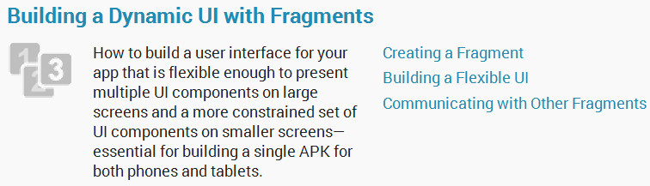
Building a Dynamic UI with Fragments

Slide 3
Intro
To create a dynamic and multi-pane user interface on Android, you need to encapsulate UI components and activity behaviors.
This class shows you how to create a dynamic user experience with fragments and optimize your app's user experience for devices with different screen sizes.

Slide 4
Lessons
Creating a Fragment
Building a Flexible UI
Communicating with Other Fragments

Slide 5
Creating a Fragment
Create a Fragment Class
To create a fragment, extend the Fragment class, then override key lifecycle methods to insert your app logic, similar to the way you would with an Activity class.
One difference when creating a Fragment is that you must use the onCreateView() callback to define the layout.

Slide 6
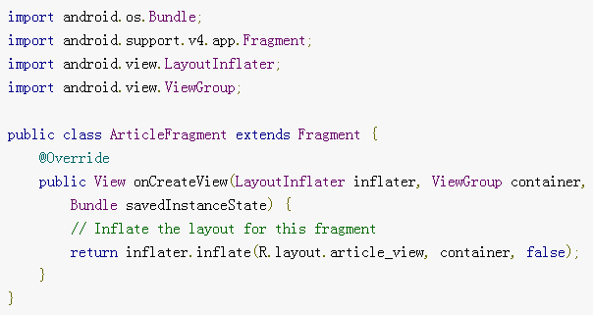
For example, here's a simple fragment that specifies its own layout:

Slide 7
Add a Fragment to an Activity using XML
While fragments are reusable, modular UI components, each instance of a Fragment class must be associated with a parent FragmentActivity.
You can achieve this association by defining each fragment within your activity layout XML file.

Slide 8
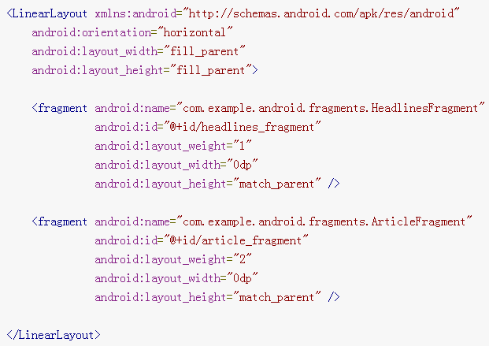
Here is an example layout file that adds two fragments to an activity
res/layout-large/news_articles.xml

Slide 9
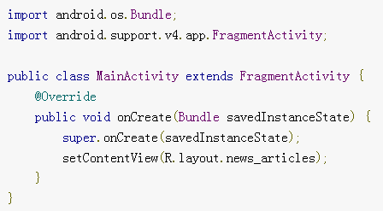
Then apply the layout to your activity:

Slide 10
Building a Flexible UI
When designing your application to support a wide range of screen sizes, you can reuse your fragments in different layout configurations to optimize the user experience based on the available screen space.

Slide 11
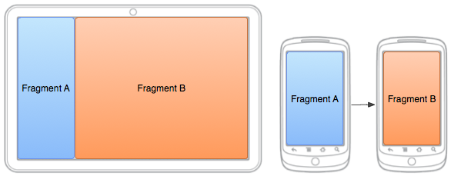
Two fragments, displayed in different configurations for the same activity on different screen sizes.

Slide 12
Add a Fragment to an Activity at Runtime
Rather than defining the fragments for an activity in the layout file, you can add a fragment to the activity during the activity runtime.
This is necessary if you plan to change fragments during the life of the activity.

Slide 13
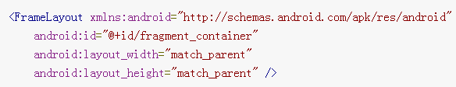
res/layout/news_articles.xml:

Slide 14
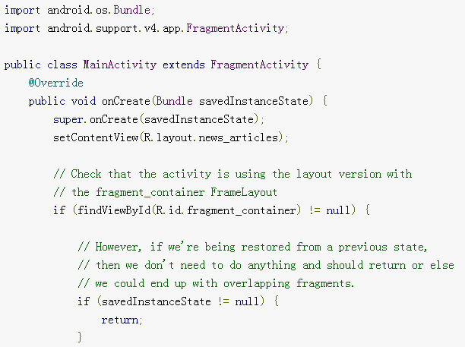
For example, here's how to add a fragment to the previous layout:

Slide 15
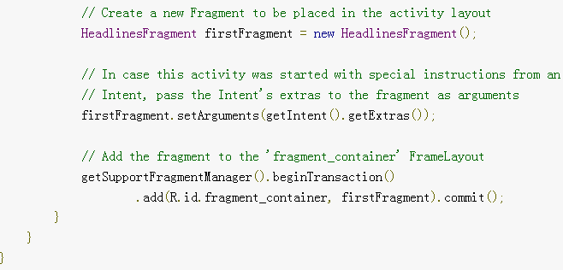

Slide 16
Replace One Fragment with Another
The procedure to replace a fragment is similar to adding one, but requires the replace() method instead of add().
Keep in mind that when you perform fragment transactions, such as replace or remove one, it's often appropriate to allow the user to navigate backward and "undo" the change.

Slide 17
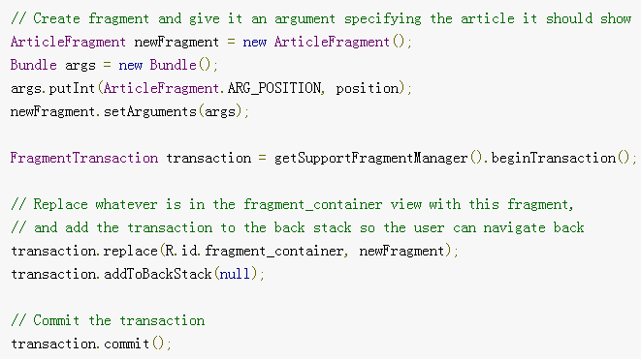
Example of replacing one fragment with another:

Slide 18
Communicating with Other Fragments
All Fragment-to-Fragment communication is done through the associated Activity.
Two Fragments should never communicate directly.

Slide 19
Define an Interface
To allow a Fragment to communicate up to its Activity, you can define an interface in the Fragment class and implement it within the Activity.
The Fragment captures the interface implementation during its onAttach() lifecycle method and can then call the Interface methods in order to communicate with the Activity.

Slide 20
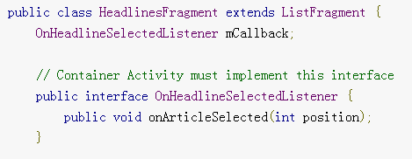
Here is an example of Fragment to Activity communication:
Now the fragment can deliver messages to the activity by calling the onArticleSelected() method (or other methods in the interface) using the mCallback instance of the OnHeadlineSelectedListener interface.

Slide 21
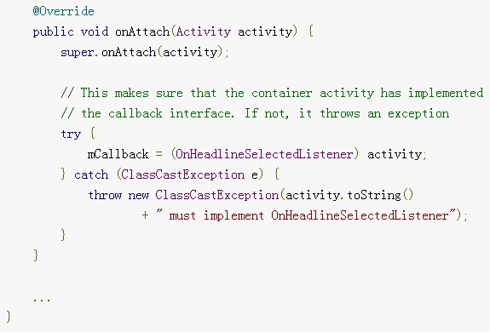

Slide 22
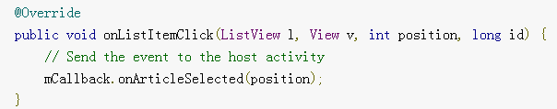
For example, the following method in the fragment is called when the user clicks on a list item. The fragment uses the callback interface to deliver the event to the parent activity.

Slide 23
Implement the Interface
In order to receive event callbacks from the fragment, the activity that hosts it must implement the interface defined in the fragment class.
For example, the following activity implements the interface from the above example.

Slide 24
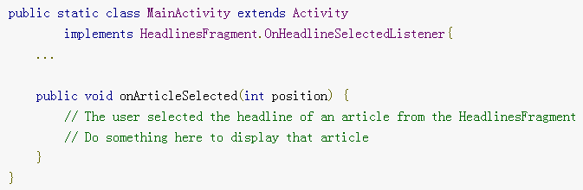

Slide 25
Deliver a Message to a Fragment
The host activity can deliver messages to a fragment by capturing the Fragment instance with findFragmentById(), then directly call the fragment's public methods.

Slide 26
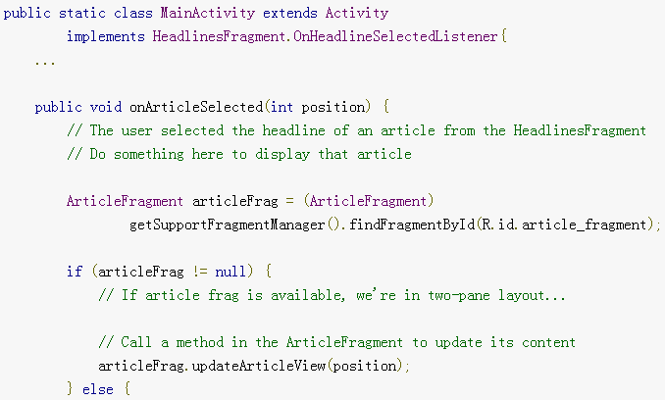
For example,

Slide 27
